Slide 1
Support Vector Machine & Support Vector Regression
Edward Wang, Ph.D.

Slide 2
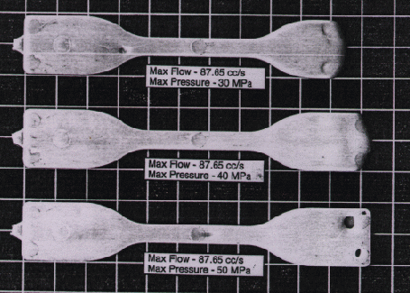
Linear Classification
Assuming:
Part dimension is only determined by peak pressure P_{p} and peak temperature T_{p} in mold;
Expressing part dimension as a binary number:
y = 1 (normal), y = -1 (short shot);
(P_{p}, T_{p})_{i}
Low P_{p} and T_{p} result in short shot defect:
(y = -1);
(Example: polymer melt did not fill the mold cavity properly)
Peak Pressure, P_{p}
y= +1
Goal:
Establish a model relating training data x_{i} = (P_{p}, T_{p})_{i} to part dimension expressed as a binary number y_{i}
(i: sample index)
y= -1
Peak Temperature, T_{p}
Short shot (y= -1) due to low pressure or low temperature

Slide 3
Support Vector Machine (SVM)
Maximum Margin
Assuming hyperplane (w∙x + b = 0) separating two categories of y; (W: hyperplane normal vector, b: number)
Boundary planes:
For Y = -1, w∙x +b = -1
For Y = +1, w∙x + b = +1
Support vectors: samples closest to the hyperplane
Margin from hyperplane to each category: ||w||⁻¹
Optimal solution: maximize margin (min ||w||)
w∙x + b = -1
w∙x+ b = 0
w∙x + b = +1
Peak Pressure, P_{p}
y= +1
||w||⁻¹
y= -1
Peak Temperature, T_{p}
Because L2 is Euclidean distance, there is always one right answer as to how to get between two points fastest. Because L1 is taxicab distance, there are as many solutions to getting between two points as there are ways of driving between two points in Manhattan!

Slide 4
Quadratic Optimization
Find w and b such that
Φ(w) =½ w^{T}w is minimized;
and for all {(w_{i} ,y_{i})}: Y_{i} (w^{T}x_{i} + b) ≥ 1
This is now optimizing a quadratic function subject to linear constraints
Quadratic optimization problems are a well-known class of mathematical programming problem, and many (intricate) algorithms exist for solving them (with many special ones built for SVMs)
Because it is quadratic, the surface is a paraboloid, with just a single global minimum

Slide 5
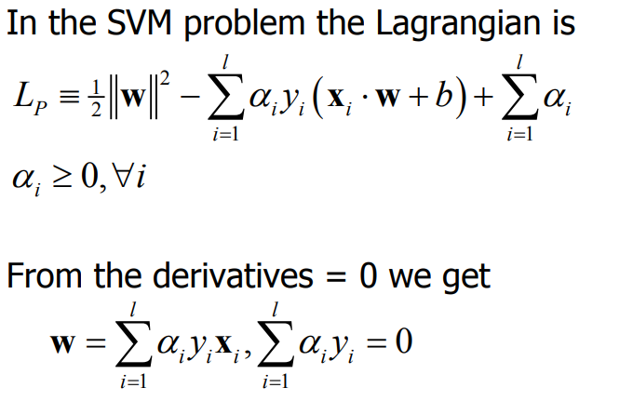
Lagrangian Formulation
a will be zero for most samples, and non-zero for the support vectors
Now find a in order to find w and b (by substituting w and b into the Lagrangian)

Slide 6
Finding a
Find α₁…α_{l} such that
Q(α) =Σα_{i} - ½ΣΣα_{i}α_{j}y_{i}y_{j}x_{i}x_{j}^{T} is maximized and
(1) Σα_{i}y_{i} = 0
(2) α_{i} ≥ 0 for all α_{i}
Take the derivative w.r.t. a and set it equal to zero, we can find a
f(x) = Σα_{i}y_{i}x_{i}x^{T} + b

Slide 7
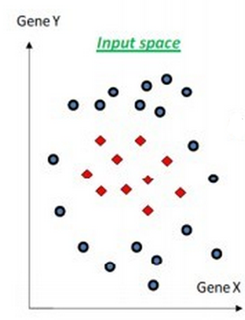
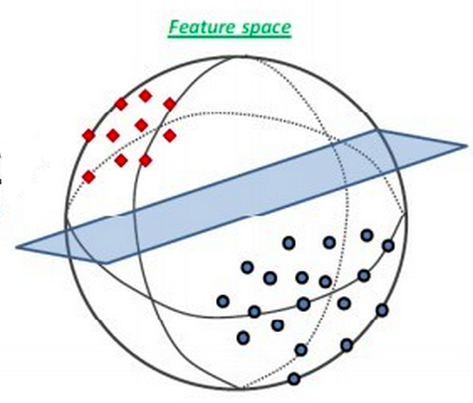
SVM for Nonlinear Classification
Mapping non-linear classification in low-dimensional space to linear classification in a high-dimensional space, via transformation φ(x);
Classification is expressed with support vector x_{i} as:

Slide 8
Kernel Trick
Enable calculating inner product <x_{i} • x> first, then nonlinear mapping, improving computational efficiency
Gaussian radial basis function (RBF): commonly used when prior knowledge of data is unavailable
Other kernel functions:
Polynomial: K(x1,x2)=(<x1,x2>+1)²
Linear: K(x1,x2)=<x1,x2>

Slide 9
Support Vector Regression-Linear
Find a function f(x) = w^{T}x + b that has at most ε deviation from regression target y (part quality) for all data x (measured parameters)
Critical points, with |w^{T}x + b –y| = ε, also called support vector, construct the regression plane
support vector
ε
w^{T}x + b –y = 0
y: Part thickness
x: Peak temperature T
The value of ε can affect the number of support vectors used to construct the regression function. The bigger ε, the fewer support vectors are selected. On the other hand, bigger ε results in more ‘flat’ estimates

Slide 10
Support Vector Regression-Nonlinear
Map x into high dimensional space via a kernel function, where nonlinear regression becomes linear regression
Poor approximation of nonlinearity with small ε
Kernel
Φ
y
y
ε
Φ(ε)
Φ⁻¹
ε
ε
Φ(ε)
ε
y: Part thickness
x: Peak temperature T
Φ(x):
x: Peak temperature T

Slide 11
SVR: Outliers
Introduce slack variables to allow outliers to lie outside the regression range:
Optimization target becomes minimizing:
Parameter C determines the trade off between the model complexity (flatness) and the degree to which deviations are tolerated

Slide 12
SVR Lagrangian

